Slide 1

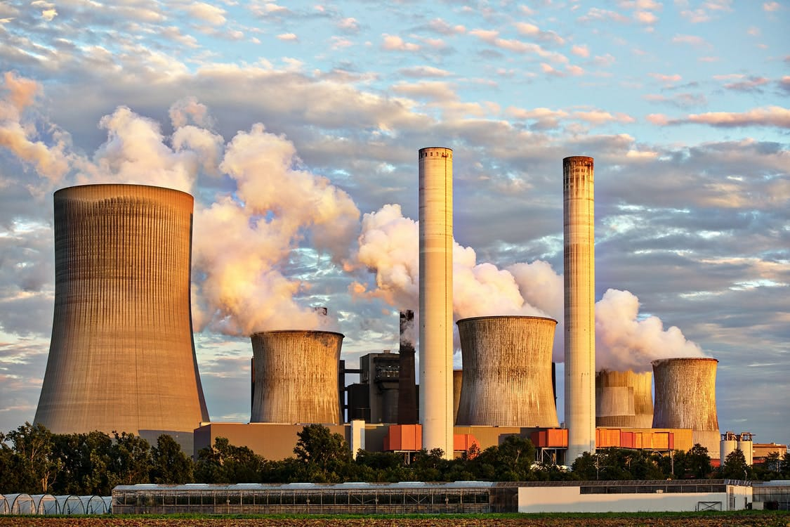
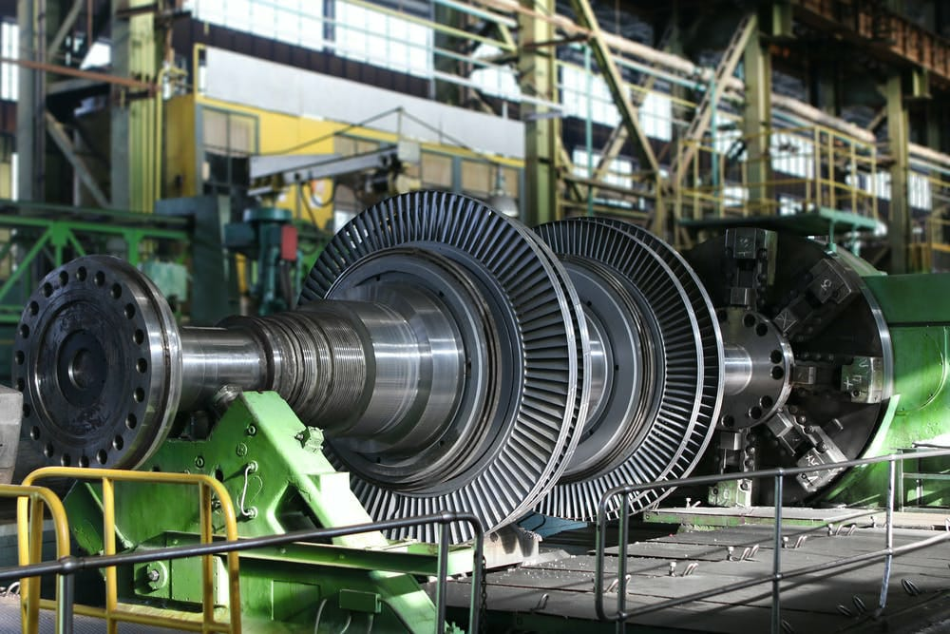
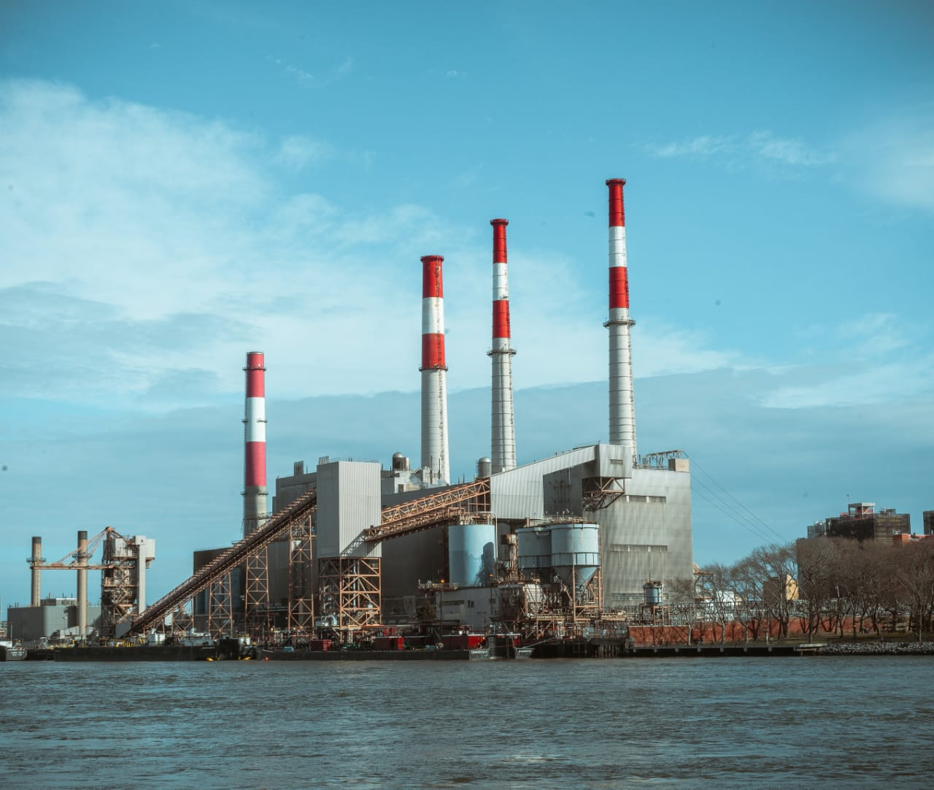
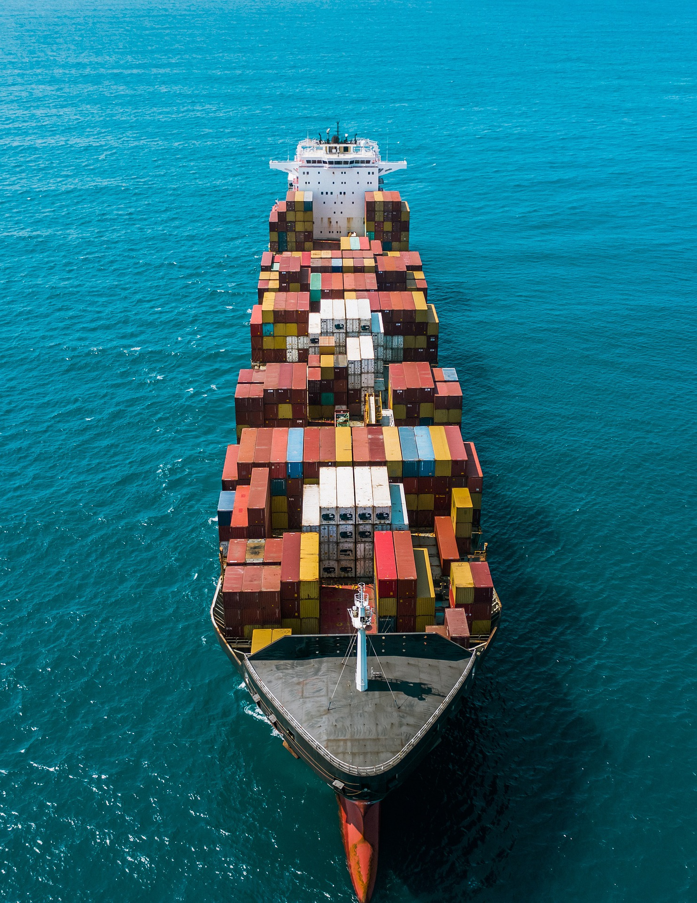
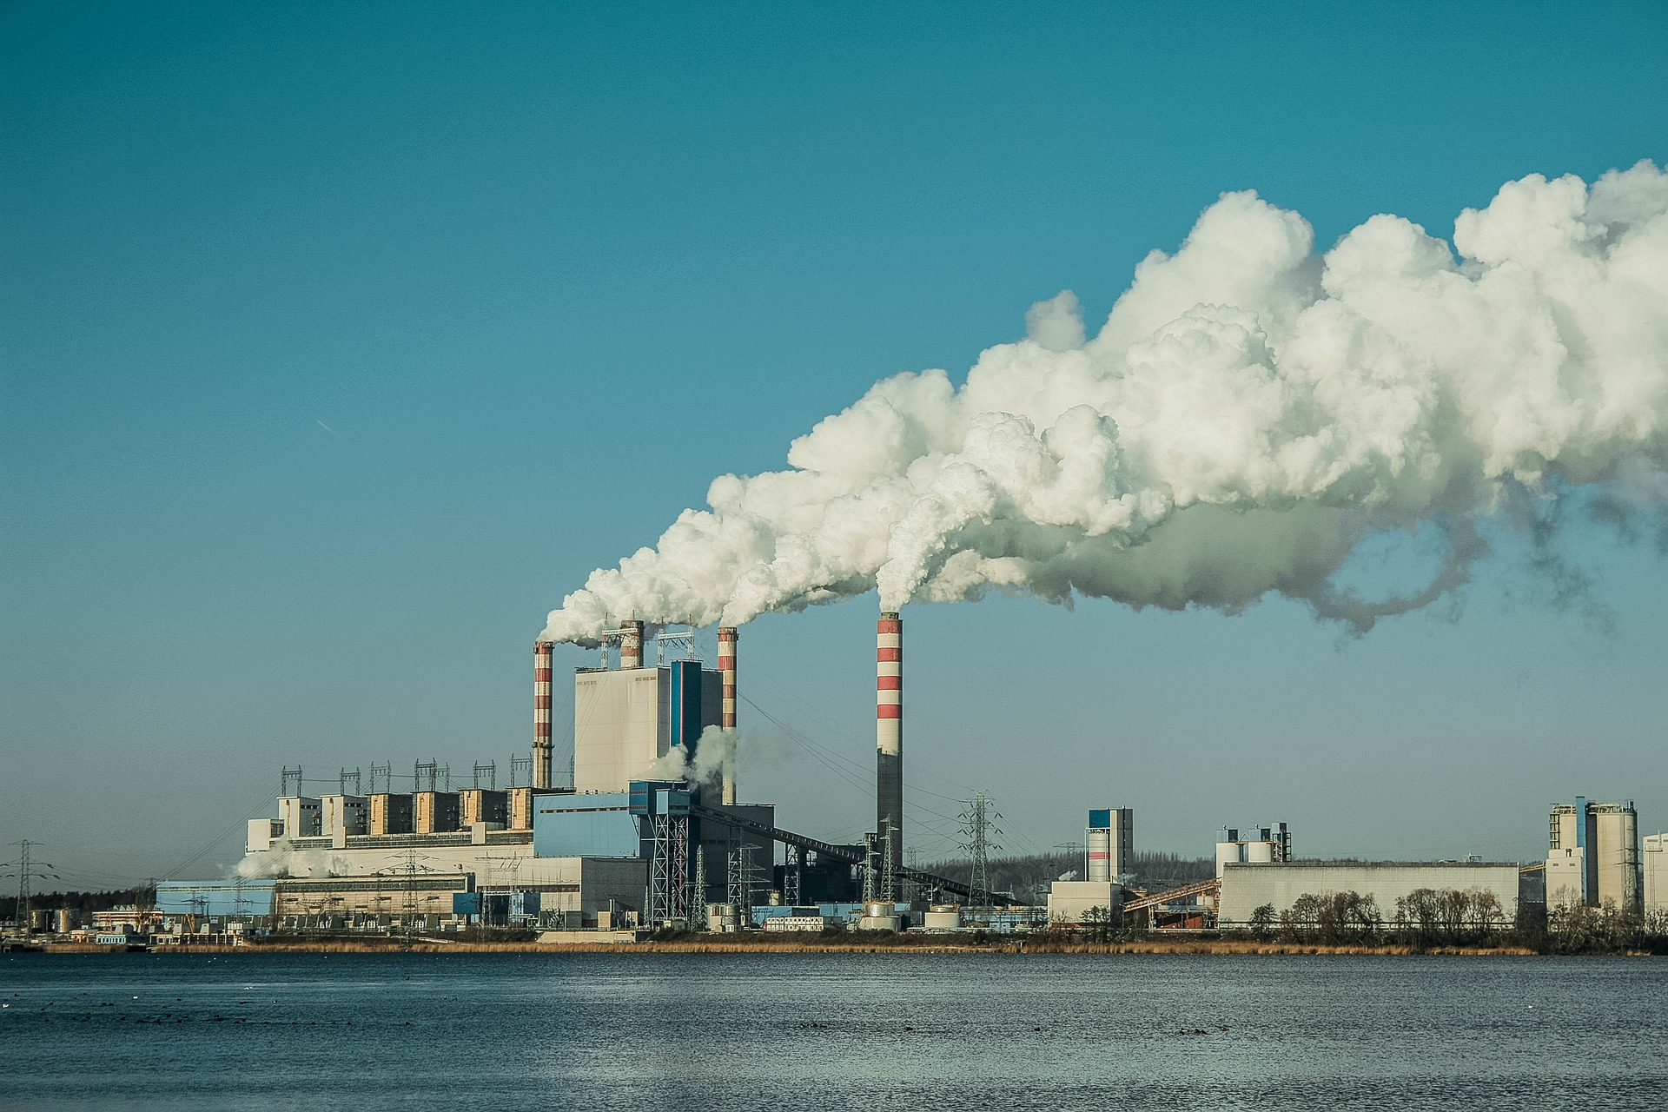


Karam Al-Arrouba Co.

Slide 2


Contents
01
02
03
About us
Business AREA
Business reference

Slide 3
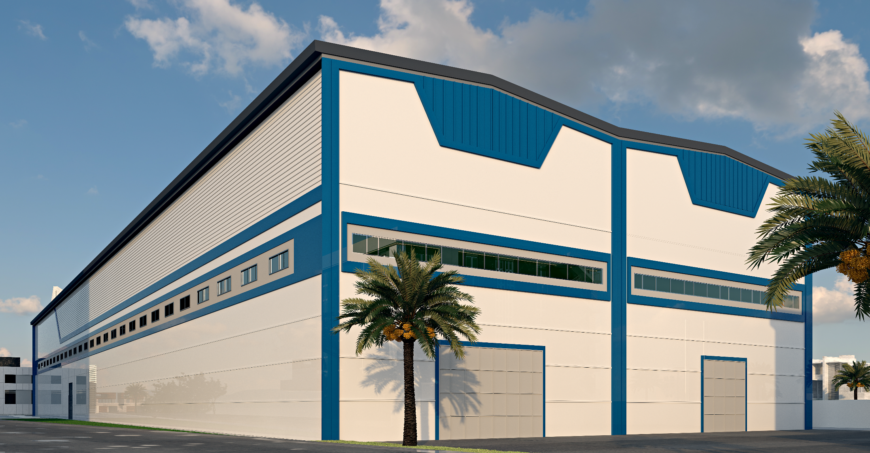
Chapter 01. About Us
About Us
01. Company Introduction
02. Group Corporate Structure
03. Business Area

Slide 4
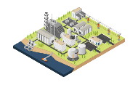

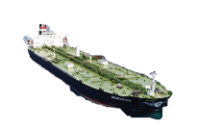
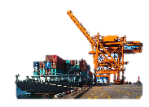
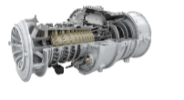


01
About Us
Company Introduction
Company Summary
Organization and Business Area
Company | Karam Al-Arrouba Co.
CEO | Mohammed Al-Hasani
Date of Establishment | March 16th, 2012
Major Business Area | Real estate investments, Maintenance and Rehabilitation of Electrical Stations
HQ Address | Iraq – Baghdad – Mansour-Al-Amerat St. nearby Hunting Club D.609/ St.8 /H.8-1
Website | www.ka-ltd.com
CEO
CFO
COO
General Affairs
Sales & Financing
Engineering
Business Operation
Engineering
Project Development & Operation
Finance
General Trading
Logistics & Transportation

Slide 5


02
About Us
Group Corporate Structure
KA-Group
(Karam Alliance Group)
Karam Al-Arrouba
General Energy
Alliance / SPC Company
IRAQ
Emirate Technology
Global Superior Energy
Global Superior Power Solution
Superior Technology Systems
Rabea Al-Mohannad
Project Development
Project Financing
Project Operation
Engineering
Construction
Trading & Logistics
Consulting Service
Project Development
Financing Agency
Engineering
Trading & Logistics
UAE
Superior Technology Systems FZ LLC
General Energy development DMCC
GUAEC
KOREA, UK
General Energy
Alghani General Trading

Slide 6


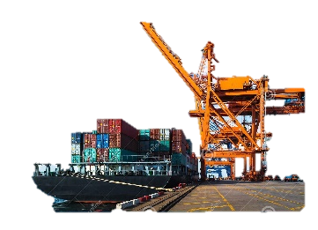

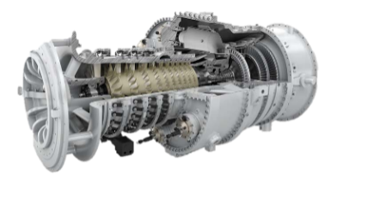

03
About Us
Business Area
Project Development & Operation
General Trading
Logistics & Transportation
Engineering
Finance
Gas Turbine Power Plant
Thermal Power Plant
Nuclear Power Plant
Water Desalination Plant
Manufacturing Plant
Assembly Factory
Power Generation Project
Manufacturing Plant Project
SOC Investment Project
Project Initiation
Project Planning
Project Financing
Project Execution
Crude Oil
LNG/LPG
Material/Component
Medical Products
General Merchandise
Bio Products
Eco-Friendly Products
Engine/Parts
Heavy Equipment
Vehicle
Supply Chain Management
Export Logistics
Procurement
Inventory Management
Ship Chartering & Operation

Slide 7
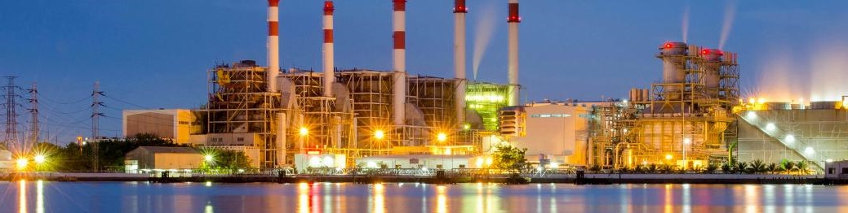

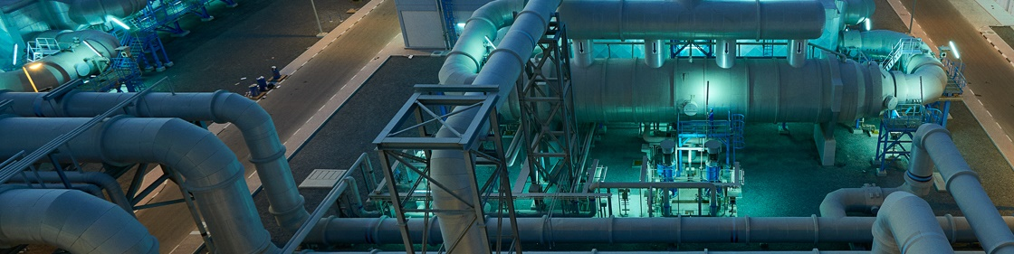
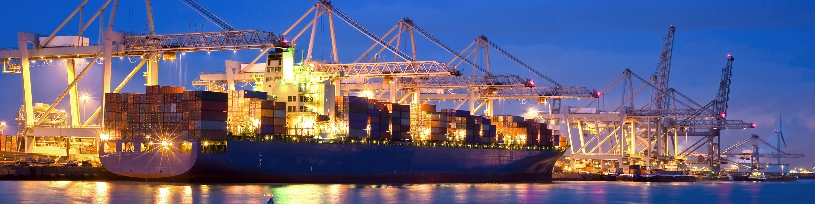
Chapter 02. Business Area
Business Area
01. Engineering
02. Project Development & Operation
03. Finance
04. General Trading
05. Logistics & Transportation

Slide 8
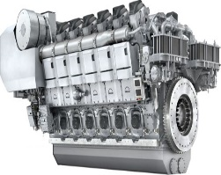
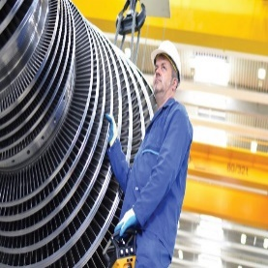
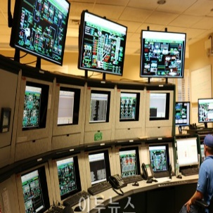
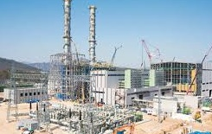
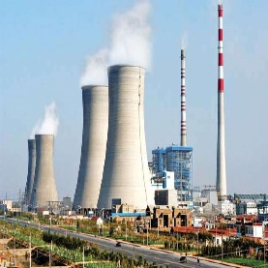
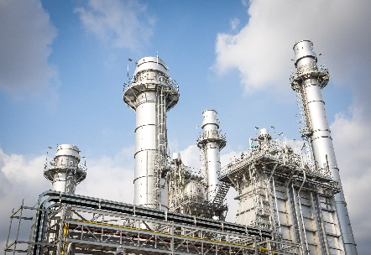
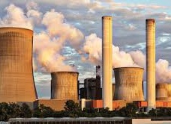
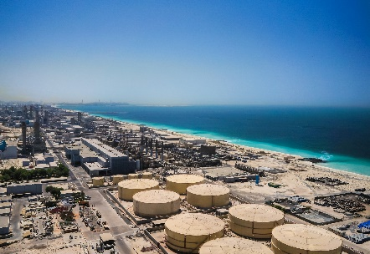
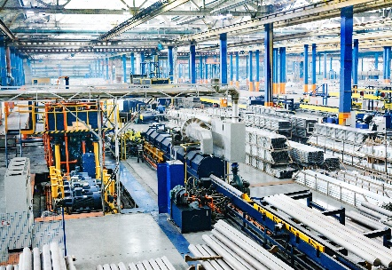
01
Business Area
Engineering
Global Engineering Service Provider for Industrial Plant
Equipment &
Parts Supply
Overhaul &
Rehabilitation
Operation &
Maintenance
Engineering
Procurement
Construction
Independent
Power Producer
Gas Turbine Power Plant
Steam Turbine Power Plant
Water Desalination Plant
Manufacturing Plant

Slide 9
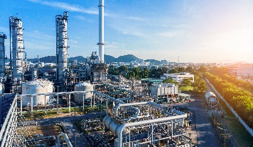
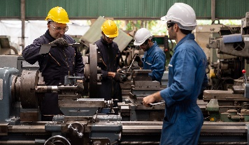

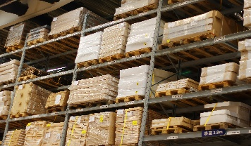



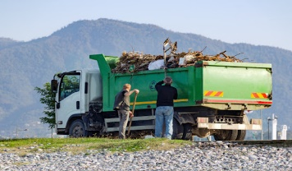
02
Business Area
Project Development & Operation
Project Development
STEP 01
Development of Project Ideas
STEP 02
Preparation of
Detailed Concepts
STEP 03
Budget Calculation & Feasibility Study
STEP 04
Site Acquisition & Approval
STEP 05
Finding and
Integrating
Business Partners
STEP 06
Project Financing
STEP 07
Project Execution
Project Operation
Commercial Operation
Maintenance
Investment Planning
Procurement
Production Management
Performance Monitoring
Contractual Affairs
Disposal

Slide 10
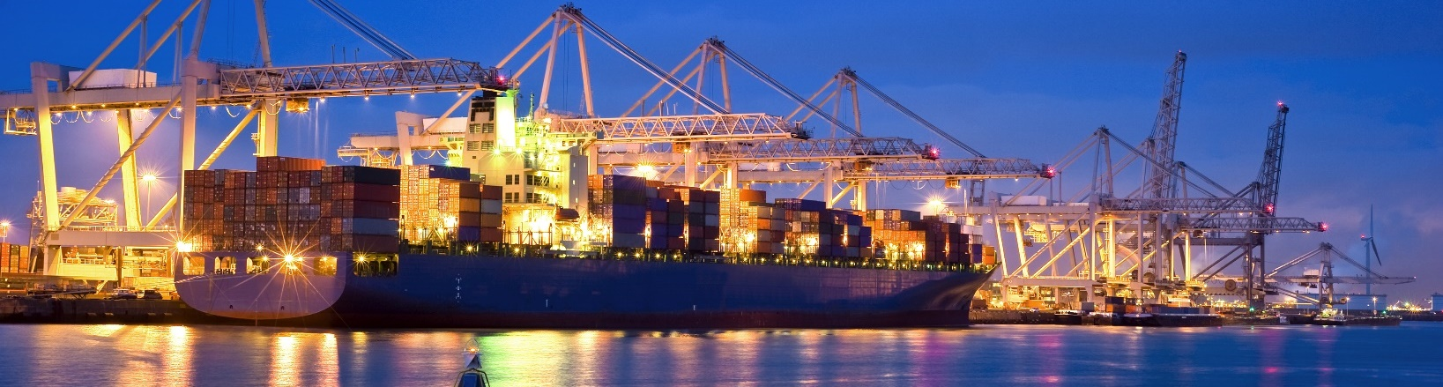





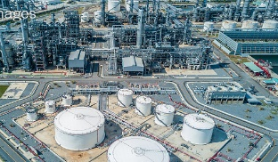





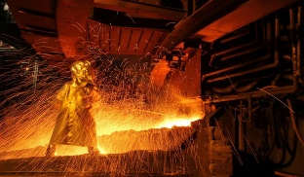
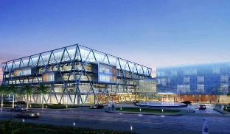
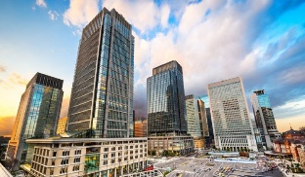


03
Business Area
Finance
We provide multiple financial solutions to structure the project’s monetary, fiscal and financial stability.
Project Initiation: From exploring project needs to evaluating business feasibility.
Project Planning: Project engineering & planning, including a feasibility study of the execution.
Project Financing: Obtaining necessary finance to carry the project in execution.
Project Execution: Executing, controlling(construction included), and maintaining continuity of the project.
Main Area
Main Country
Infrastructure
Industrial facility
Trading
Energy Resources
Social Infrastructure
Real Estate

Slide 11
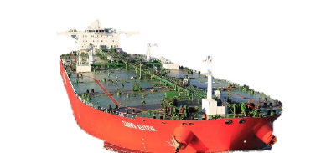
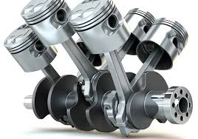
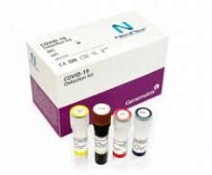
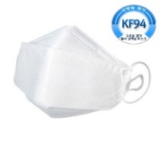
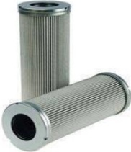
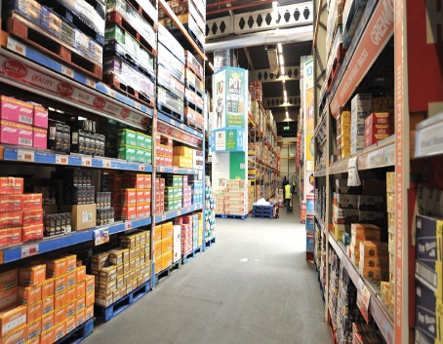

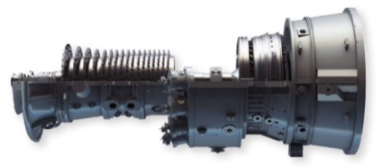


04
Business Area
General Trading
Oil & Gas
Engine / Parts / Material
Medical Products
General Merchandise
Crude Oil & LNG/LPG
Petroleum Product
Petro-Chemical Product
Engine, Parts, Machinery for Power Plant
Filters & Other Consumables
Pharmaceutical Drugs
COVID-19 Test Kit
KF94 Masks
Medical Gloves, etc.
Consumer Goods
Bio/Eco-Friendly Products
Electronic Device, Cosmetics, Apparel, etc.

Slide 12




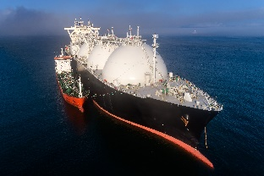
05
Business Area
Logistics & Transportation
Supply Chain
Management
Export Logistics
Procurement
Inventory Management
Ship Chartering
& Operation
Management
Interconnection
Visibility
Flow
Market Development
Market Research
Market Analysis
Export Management
Export Consultant
Shipping Agency
Sourcing
Negotiation
Ordering
Monitoring
Inspection
Payment
Recordkeeping
Stock Forecast
Time Management
Inventory Control
Cost Reduction
Stockout Prevention
Tanker
Bulk Carrier

Slide 13
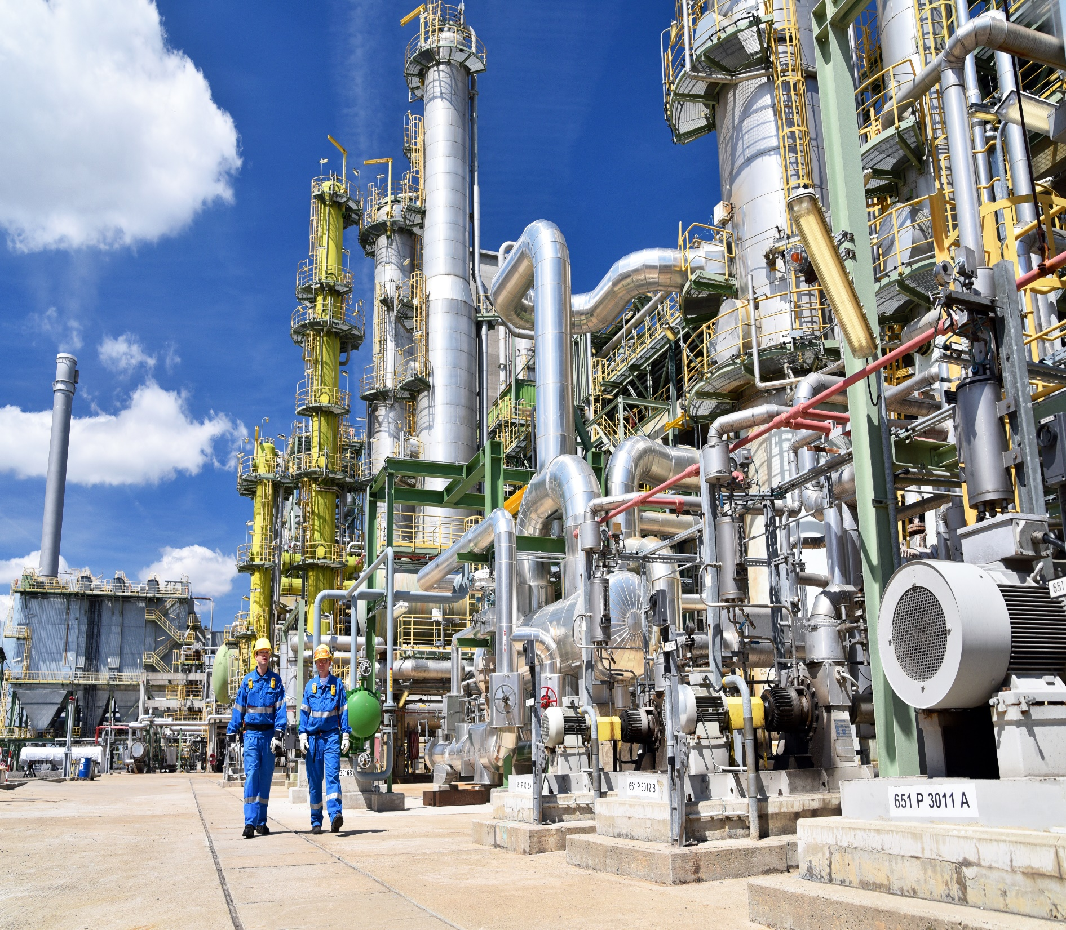
Chapter 03. Business Reference
Business Reference
01. Gas & Steam Turbine Business
02. Lubrication Oil Blending Business
03. Filter Manufacturing Business
04. Under Development Project

Slide 14

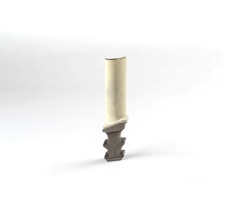
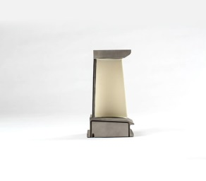
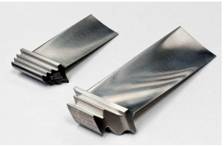
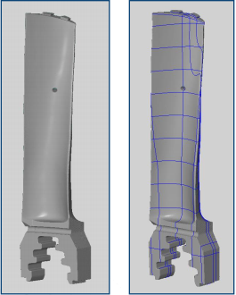
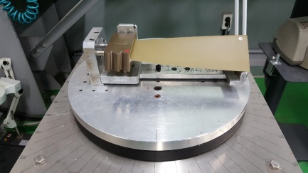
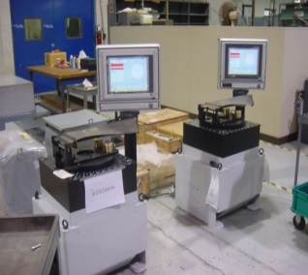
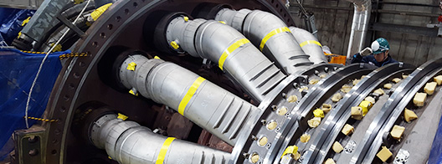
01
Business Reference
Gas & Steam Turbine Business
Business Overview
Project | Turbine Workshop
Client | Government, Private
Production Capacity | Gas Turbine 130~168 parts per 5 years (parts refurbishment) 432 parts per 5 years (rotor maintenance) Steam Turbine 58 parts per 5 years (parts) 54 parts per 5 years (rotor)
Objective | Gas/Steam Turbine Parts regeneration/repairment GE Frame 9E GE LM 6000 Siemens SGT5-2000E Siemens SGT5-4000F Siemens SGT-800E Alstom GT13E2 Alstom GT13D
Our Specialty/Service | Plant Engineering & EPC Consulting, EPC Logistics, Supervision for Production (Quality management with partner company)
Period | 25 years (2021~2046)
Partnering Companies | SUNG-IL TURBINE P&S

Slide 15
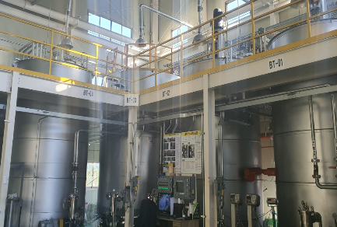



02
Business Reference
Lubrication Oil Blending Business
Business Overview
Project | Lubrication oil Blending Plant
Client | Government, Private
Production Capacity | 3,600 ton/month 44,000 ton/year
Objective | Lubrication oil manufacturing Diesel Engine oil Turbine oil Hydraulic oil Transformer oil Heat Transfer oil Gear oil Grease
Our Specialty/Service | Plant Engineering & EPC Consulting, Raw material and Product Logistics, Plant Operation & Maintenance, Supervision for Production (Quality management with GS Caltex)
Period | 25 years (2021~2046)
Partnering Companies | GS Caltex

Slide 16





03
Business Reference
Filter Manufacturing Business
Business Overview
Project | Filter Manufacturing Plant
Client | Government, Private
Production Capacity | 49,400 EA per Year (Intake Air Filter)
Objective | Filter Manufacturing Cartridge filters Statistic filters EDM filters Nuclear hepa filters Pre filters Bag filters High temperature filters Carbon filters Diesel Power Plant Lube oiI fiIters
Our Specialty/Service | Plant Engineering & EPC Consulting, EPC Logistics, Supervision for Production (Quality management with partner company)
Period | 25 years (2021~2046)
Partnering Companies | PNC CO., LTD, FILTECH

Slide 17

Iraq – Baghdad – Mansour-Al-Amerat St.
nearby Hunting Club D.609/ St.8 /H.8-1
www.ka-ltd.com

